Slide 1


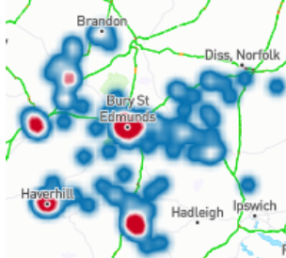
Using Benson Community to Improve Quality in West Suffolk
QNI CNEN Presentation (for circulation)
19 April 2024

Slide 2
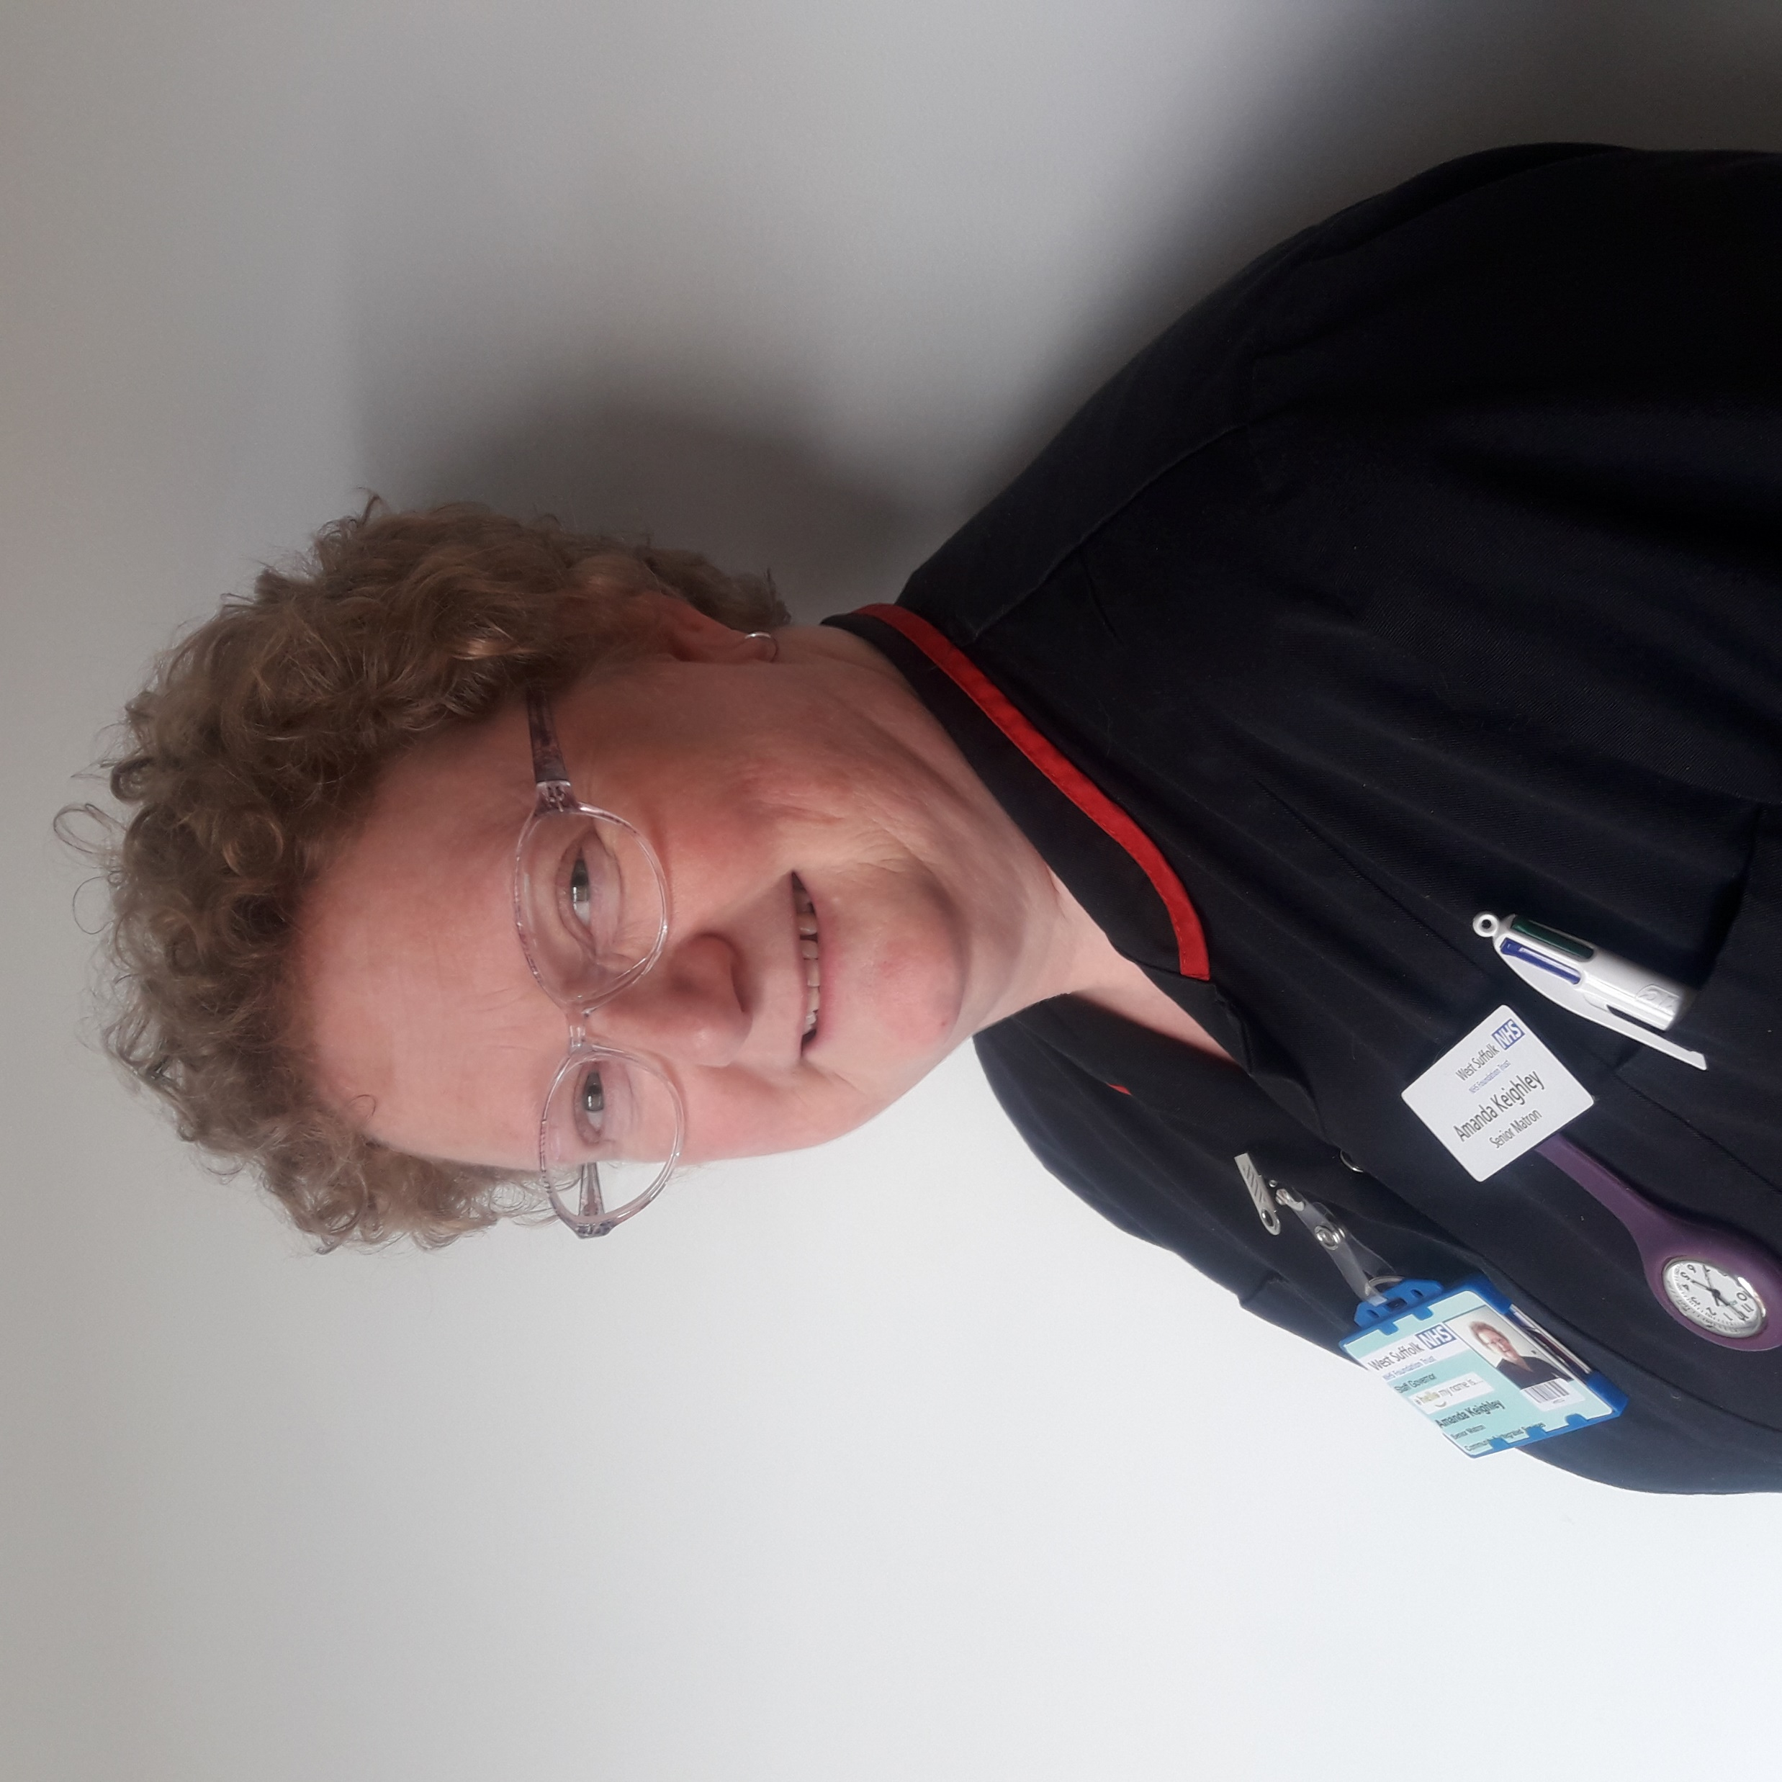
Speaker
Amanda Keighley
Senior Matron, Community and Integrated Services Division
West Suffolk NHS Foundation Trust
amanda.keighley2@wsh.nhs.uk

Slide 3
How Benson has helped improve quality in West Suffolk
Amanda Keighley - Senior Matron, WSFT
My role
Oversight of six regional teams
We have used Benson since 2019 and now have 30 individual users
Focus on quality:
Identifying local good practice
How are individual teams performing?
How does this compare with other providers?
Impact for governance, how do we achieve this across all teams?
How do we apply Benson to assess & improve quality in community nursing?
MILDENHALL
BURY RURAL
NEWMARKET
BURY TOWN
HAVERHILL
SUDBURY

Slide 4
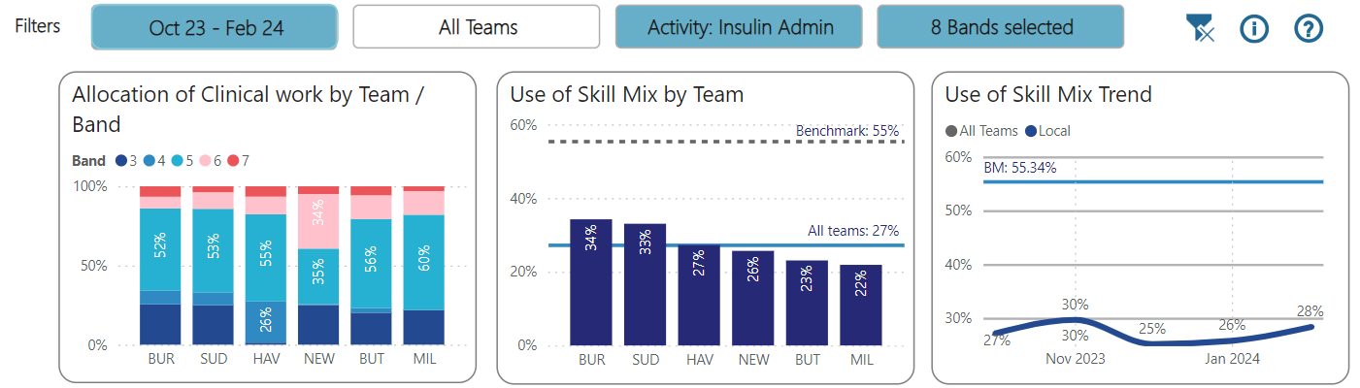
Example #1 Allocation of Insulin work to Skill mix
This chart shows how our teams used skill mix (Bands 3 & 4 ) to administer Insulin between Oct 23 and Feb 24
We would expect our teams to skill mix 30 to 40% of Insulin interventions
This information helped a business case to increase skill mix in some teams
This is helping introduce new skills to lower bands
Managers track changes in these outcomes from Benson reports

Slide 5
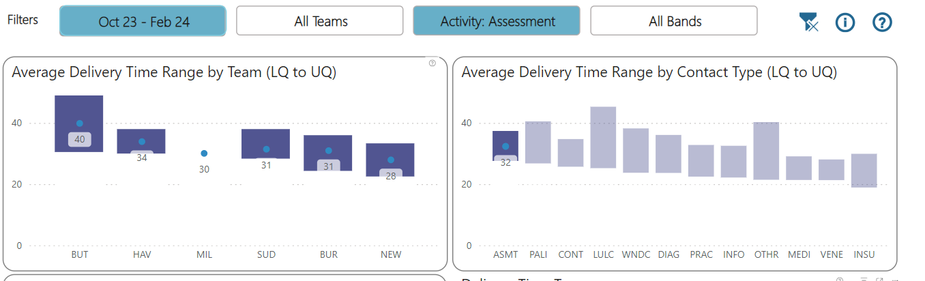
Example #2 Monitoring clinical duration
These visuals show how much time staff are recording for Assessments and the range across our six teams
As a quality measure we would expect a first assessment to last 45 mins
Some teams would appear to be under the expected time, with the lowest on average under 30 minutes per Assessment
This allows us to discuss with teams where pressures are and the value of skill mixing (per prev. slide) to release time to do better assessments
This also introduces a potential data quality issue – where nurses are not outcoming actual duration. See Millenhall team where all duration = 30 mins

Slide 6
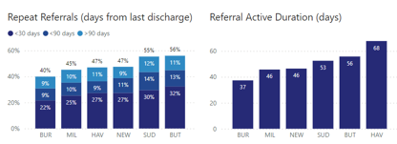
Example #3 Referral metrics
The Insight report allows us to view various referral metrics, including intensity and longevity of referrals
This allows us to speculate and investigate which teams have patients on their caseloads longer by comparison
The chart on the top shows % repeat referrals
We can investigate why some teams have much higher repeat referrals than others

Slide 7
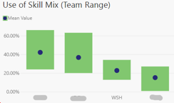
Example #4 : External Benchmarking
The Benchmarking report allows WSFT to compare metrics with selected providers
Evidences demand / capacity and provides objective comparison to reassure Exec
Evidences strengths and positive outcomes, generates curiosity and challenge and reassurance to teams
In this example, Benchmarking allows WSFT to compare how much Insulin work is allocated to skill mix staff vs selected providers
These insights inform new discussions and strategies around clinical roles
Insulin: allocation to skill mix by provider

Slide 8
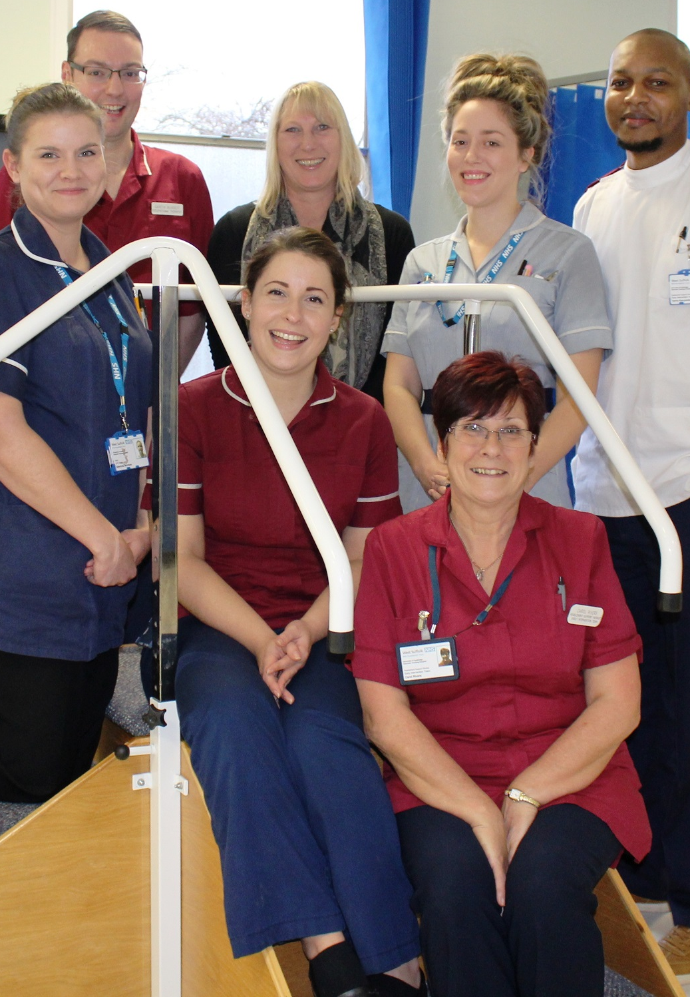
Example #5 Service Level Reviews
Each CN team has a six-monthly SLR
They prepare and report their metrics to the Executive
Benson provides evidence of each team’s productivity, effectiveness, & risk profile
Benson can help to triangulate recommendations and reflect against CNSST, our national staff survey results
Example: Bury Town
Staff are feeling disjointed from the organisation
Productivity very high – possible burnout?
Can we move people around?

Slide 9
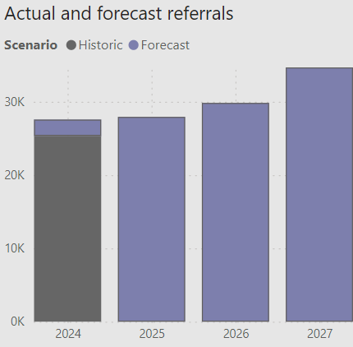
2024 goals and development
Application of the planning report to inform future development and staffing across our teams
Integrating care pathways delivered by Community matrons
Launch of new Community Therapies report
Launch of new Virtual Ward report
Continue rollout to senior staff across the organisation
Forecast referrals from planning report

